Slide 1
United Nations Development Programme
Pipeline Management
Introducing the Quantum+ UNITY “Partnership Opportunities” module
Updated: June 23 2023

Slide 2
What is pipeline management?
Pipeline: “The totality of planned programmes, projects, and initiatives that UNDP Headquarters, Regional HQ, and local units/offices are expected to pursue within a foreseeable time in the future.”
Identification of new ideas
Development of ideas into project proposals
Maturing of proposals into fully formed projects
Pipeline Management:

Slide 3
What is an Opportunity?
The Pipeline of a Business Unit (Department) is referred to as “Quantum+ Opportunity” and given a unique Opportunity ID (Opportunity Record Type: Funding).
An Opportunity is a record of key data concerning a partnership under negotiation with a potential or existing partner. It covers the timespan between the inception of the opportunity up to agreement signature (or up to the withdrawal from negotiations). A partnership opportunity results to an agreement, either a financial or a non-financial agreement such as a Funding Agreement, a Letter of Agreement, MoU, or Statement of Intent.
An Opportunity also refers to the negotiations surrounding the revision to an existing Project.

Slide 4
Why is pipeline management so important?
Pipeline management supports two key objectives:
Strategic – it ensures that UNDP remains focused and the programme portfolio globally, regionally and locally is consistently framed within the Strategic Plan.
Financial – it enhances the ability of UNDP to leverage and maximize various partnerships and opportunities for development financing. It also contributes to ensuring financial sustainability of the organization through enabling better informed and more accurate resources projections and making necessary adjustments in internal resource planning.

Slide 5
Budgeting over multiple years under Project level co-financing
UNDP Strategic Plan
National Priorities
UNDAF
CPD
D e v e l o p m e n t R e s u l t s
As reflected in PRODOC & subsequent re-phasing budget revisions – activities/inputs
Pipeline
Substantive budget revisions (+$)
Approved
Project
Output A
Year 1
Year 2
Total $
Output
A
$
Output B
Year 1
Year 2
Year 3
Total $
Output C
Year 2
Year 3
Total $
Output
C
$
Pipeline
new Project (maturity class A)
Year 1
Year 2
Year 3
Total $
T o t a l $ f o r p l a n n i n g, p r o g r a m m i n g a n d
b u d g e t i ng

Slide 6
How does the Pipeline Management module help us achieve these goals?
Country Offices, Regional and HQ Departments will benefit from:
a system to manage opportunities for a new project from ideation to the signing of the project document
a corporately-endorsed methodology for predicting volume of future projects and income
a common reporting platform for resource planning
A corporate digital repository of all financial and non-financial agreements
Regional Bureaux will benefit from:
a systematic capture of Country Office pipeline information
a standardized methodology of assessing pipeline maturity
a system to link pipeline outputs and show alignment to the new Strategic Plan
a common reporting platform for resource planning
Real Time visibility to new Partner Negotiations

Slide 7
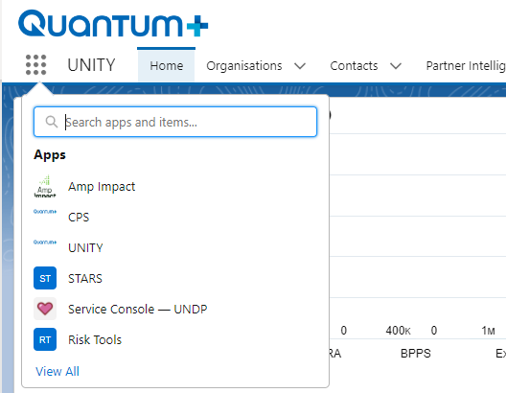
How can we access the Pipeline and Partner Management module (UNITY) in Quantum+?
UNITY is a module that resides in the Quantum+ platform. Other tools in Quantum+ are STARS, CPS, and the Risk Tools. There is no direct link to UNITY. When you click the Quantum+ url https://undp.lightning.force.com/ the system displays the last module that you were using. If you were using UNITY it will display the UNITY home screen. If you were using CPS, the CPS home screen. If this is the first time you visit Quantum+ then the CPS home screen will be displayed which is the first module in the list of available modules in Quantum+.
To switch to UNITY, at the top left of your screen, click the rectangle icon and select UNITY.

Slide 8
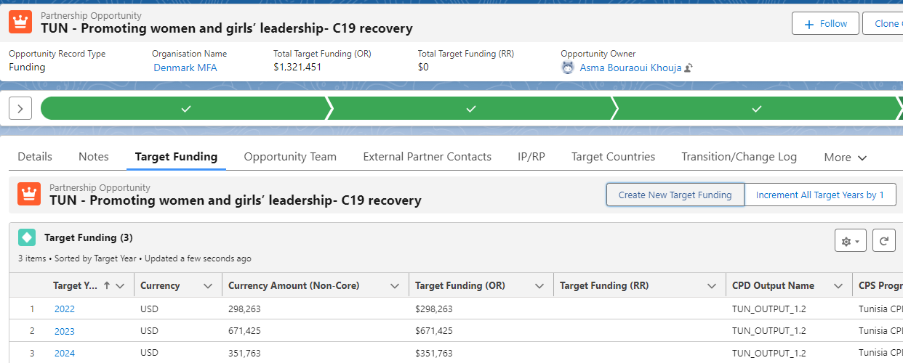
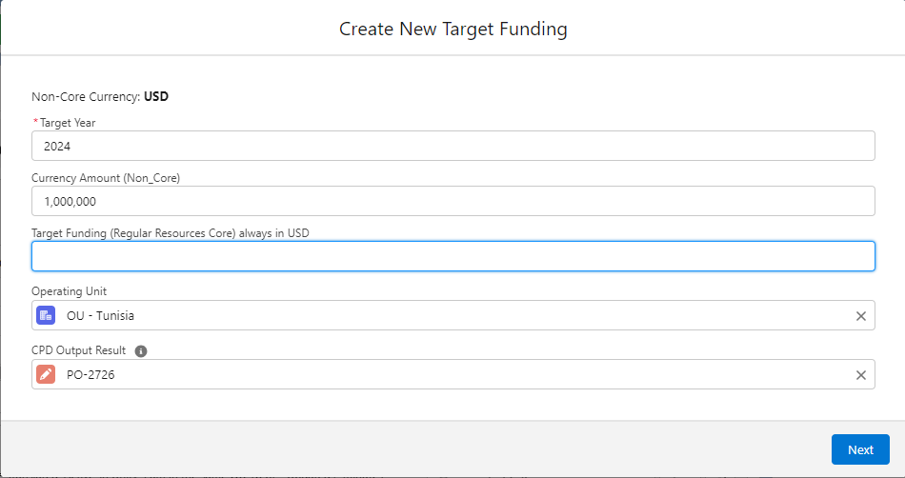
How can we link the Pipeline to the CPD Outputs
In an opportunity, Navigate to the Target Funding tab, Create a new Target Funding record, search for and select the CPD Output. You can associate multiple CPD Outputs to an Opportunity.

Slide 9
How do we test the maturity of our pipeline?
Criteria | Questions | + | -
1. Demand for services | Evidence of need for project?
2. Enabling environment | Evidence of conducive local environment? Risks?
3. Availability of UNDP substantive expertise | Within a UNDP core area of expertise?
4. Availability of critical partners? | Implementing partner/s? Substantive partner/s? Funding partners?
5. Degree of development | Defined project strategy, results & activities
Maturity level captured in UNITY
Stage C | Stage B | Stage A
Ideas (30%) | Soft Pipeline (50-70%) | Hard Pipeline (90%)

Slide 10
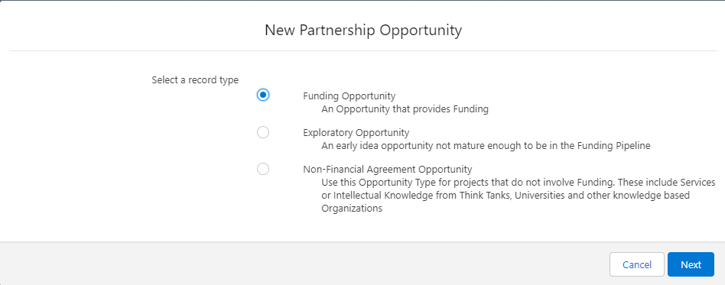
What are Exploratory Opportunities?
Exploratory Pipeline: This is the soft-soft pipeline of Departments. It is the incubator phase prior to entering the Funding Maturity model of Stages C/B/A where we don’t yet know if a Partner will fund a project, sign a pro bono agreement, or even not be interested to engage. Exploratory opportunities are not part of the corporate funding pipeline and at this stage the Partner might not even be known. Exploratory opportunities are solely for the use of Departments to keep track of concepts they consider for exploration.

Slide 11
How can resource projections be derived from pipeline data?
Discounting dependent on maturity
Opportunity | Projected budget (broken down by year) |  | Adjusting factor in non-core (broken down by year) | Revised non-core value | Cost-recovery Rate (broken down by year) | Delivery rate | Projected XB (GMS) earning
 | Core | Non-core
Stage A pipe line projects | Inputted value | Inputted value | 10% | Calculated | 7% 3% 8% Exceptions | Inputted value | Calculated
Stage B pipe line projects | Inputted value | Inputted value | 30% to 50% | Calculated | 7% 3% 8% Exceptions | Inputted value | Calculated
Stage C pipe line projects | Inputted value | Inputted value | 70% | Calculated | 7% 3% 8% Exceptions | Inputted value | Calculated

Slide 12
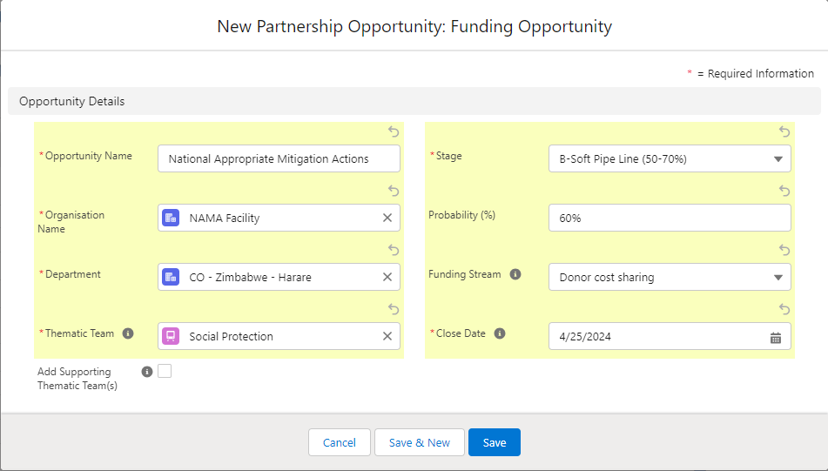
What information is being captured by the Pipeline Management module?
Assigning maturity level and identifying funding sources.
Assign maturity level
Identify potential funding source.

Slide 13
What information is being captured by the Pipeline Management module? – Complete List 1 of 2
UNITY enables departments to capture the following information:
Type of Opportunity: Exploratory, Funding, Non Funding | Mandatory
Department: Department leading the negotiations | Mandatory
Organization: Partner/Donor | Mandatory*
Thematic Team: a.k.a. Cluster | Mandatory
Stage: Maturity C/B/A | Mandatory
Probability: Refine within a spectrum | Optional
Funding Stream: Donor cost Sharing, etc | Mandatory*
Close Date: Approximate signature Date | Mandatory
Target Funding: a.k.a Tranches/Future Dues | Optional
Project ID: For amendments of existing projects | Optional
Supporting Thematic Teams: a.k.a. Clusters | Optional
Implementing Partners & Responsible Parties: | Optional
Description: Summary of Project/Target Partnership | Optional
Notes: Anything important, meeting minutes, latest status | Optional
* For some maturity Stages

Slide 14
What information is being captured by the Pipeline Management module? – Complete List 2 of 2
Emails: Associate emails from Microsoft Outlook | Optional
Currency: The Funding Currency if funding opportunity | Mandatory
Indirect Contributors: For Government Cost Sharing or other cases | Optional
Opportunity Team: The UNDP Colleagues collaborating on the opportunity | Optional
External Contacts: External Partner Contacts associated to the opportunity| Optional
Files: Concept notes, draft Pro Docs, etc | Optional
Internal Communications: Using Chatter | Optional
CPD Output Map: Associate CPD Outputs to | Optional
Status: Additional progress identifier | Optional
Topic List: Choose one or more of 54+ Services | Mandatory
Tasks: Action Plan/Immediate blocking Tasks | Optional
Call Notes: Any partner touchpoint such as a call or meeting | Optional
Events: Scheduled meetings | Optional
Opportunity Costs: Keep track of the costs associated to the opportunity | Optional
Target Countries: Countries Targeted/Benefited form the opportunity | Mandatory
Risk Assessments: Associate SESP or Private Sector risk assessments | Optional
Agreement: Agreement that resulted from the Opportunity | Optional

Slide 15
What reports are available?
Reports are primarily grouped in Dashboards. Dashboards are visual representations of reports that enable users to drill down to the underlying tabular data. Dashboards and individual reports are available via the UNITY Home Screen. Some of the available Dashboards are listed below:
Funding & Non-Funding Pipeline by Bureau/Department
UNDP Financial Sustainability Metrics
Private Sector Pipeline by Bureau
International Financial Institutions (IFIs) Pipeline by Bureau
European Union Pipeline by Bureau
Corporate/Non Corporate Foundations (Philanthropy) Pipeline by Bureau
Funding Stream Projections by Bureau

Slide 16
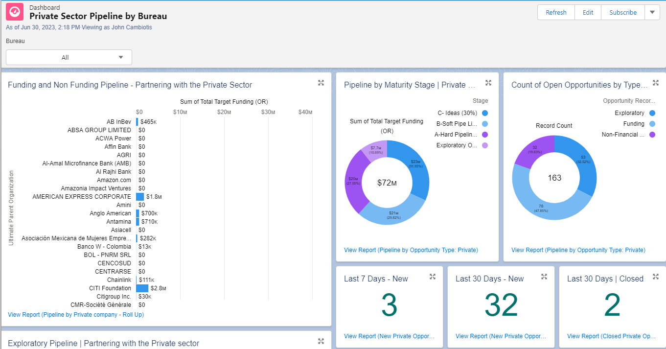
Dashboard Navigation
At the top of dashboards you can select filters. To view the tabular report for each graph, click the View Report link. You can also click on elements of graphs (a pie chart slice) to automatically filter the underlying tabular reports.
Filter by Bureau
Display Exploratory Opportunities

Slide 17
Resources By CPD Output and Bureau
Pipeline Mappings to CPD Outputs are available by Bureau and by Department.
Total CPD Output Cost for RBA
Pipeline Mapped to CPD Outputs
Resource Mobilization Target Performance Dashboards:
RBAP | RBLAC | RBEC | RBAS | RBA

Slide 18
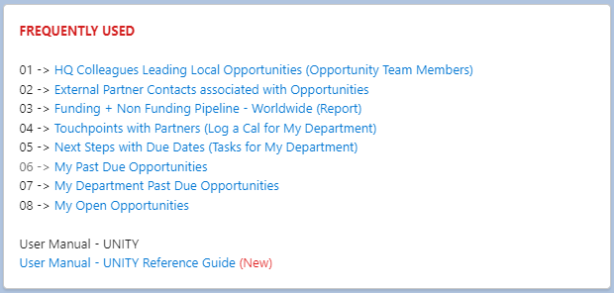
Documentation: UNITY User Manual
You can access the UNITY User Manual on this link and via your UNITY Home Page in the FREQUENTLY USED Widget. As the User Manual is updated frequently, always access the latest online version.

